Slide 1
Housing Market Analysis Bend, OR
Link to Dashboards and Reports:
Excel Dashboard 1: https://app.powerbi.com/groups/me/dashboards/ebcf0925-134a-4e3f-8325-a794518f79a9?ctid=2ba33407-5ccc-4940-bd16-ae154f04c3ca Power BI Dashboard 2:
https://app.powerbi.com/groups/me/dashboards/a8127ea1-13ab-4a9a-ae48-5bd1339051da?ctid=2ba33407-5ccc-4940-bd16-ae154f04c3ca Power BI Report:
https://app.powerbi.com/groups/me/reports/f76083e6-04e1-4072-9f12-ac5fc4037238?ctid=2ba33407-5ccc-4940-bd16-ae154f04c3ca
I was unable to get access to a Desktop version so the zip code graphs look a little unprofessional. In addition to this, I was unable to get a link to my Excel workbook (dashboard is included) but could send a downloaded version if needed.
HW3: Power BI

Slide 2
The Client
Mr. and Mrs. Smith; 3-year-old and a newborn
Mrs. works at local hospital; Mr. works remotely from home and needs an office
Looking for a 3-5 bedroom home (prefer 4-5) with at least 2 baths; looking for home with some projects to make it their own
Looking for a long-term home with no HOA; Strict budget of $750,000

Slide 3
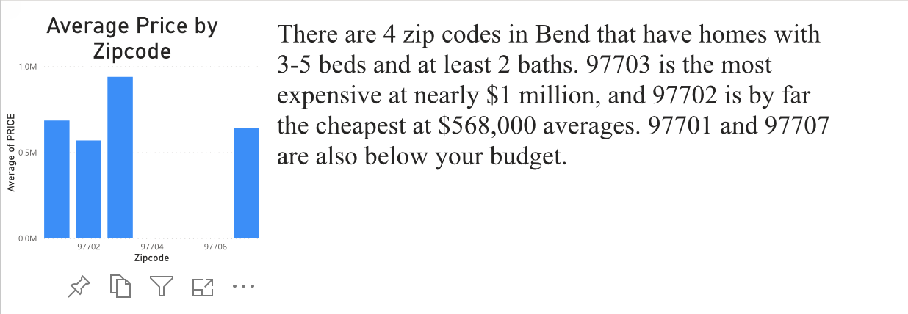
Zip Code Analysis
Technical Work:
Filter added to focus in on 3-5 Bedrooms and 2-4 bathrooms. If Desktop was available I would have used modeling to change the zip code to text instead of number

Slide 4
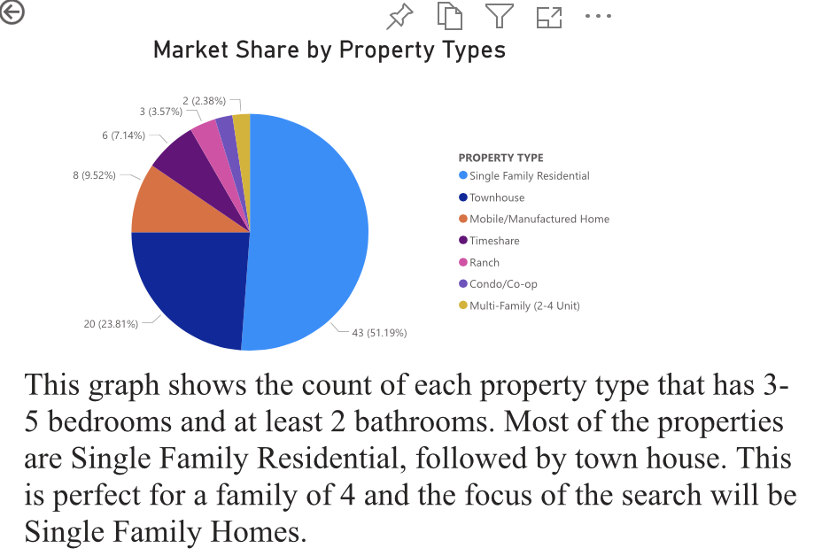
Market Share by Property Types
Technical Work:
Filter added to focus in on 3-5 Bedrooms and 2-4 bathrooms.

Slide 5
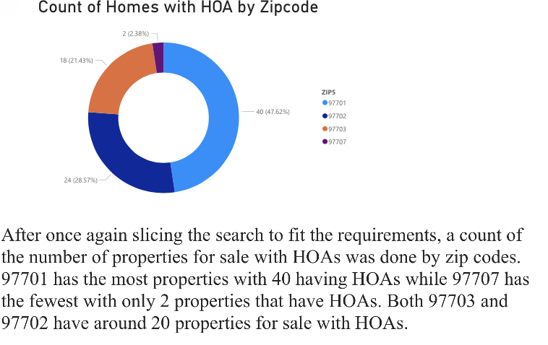
HOA Properties
Technical Work:
Filter added to focus in on 3-5 Bedrooms and 2-4 bathrooms

Slide 6
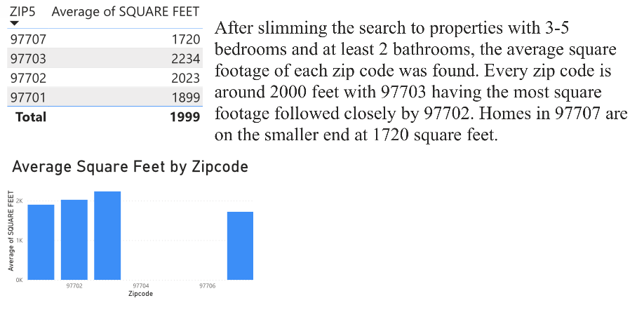
Average Square Feet
Technical Work:
Filter added to focus in on 3-5 Bedrooms and 2-4 bathrooms. If Desktop was available, I would have used modeling to change the zip code to text instead of number

Slide 7
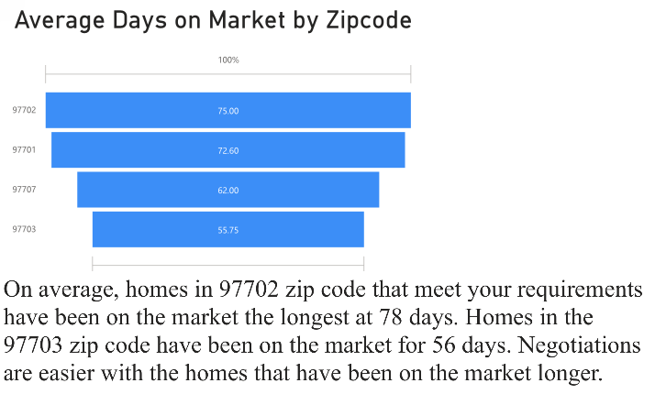
Average Days on Market
Technical Work:
Filter added to focus in on 3-5 Bedrooms and 2-4 bathrooms and only Single Family Homes and Townhome. If Desktop was available, I would have used modeling to change the zip code to text instead of number

Slide 8
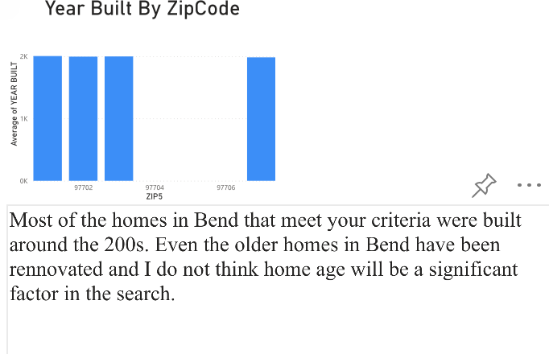
Year Built Analysis
Technical Work:
Filter added to focus in on 3-5 Bedrooms and 2-4 bathrooms. If Desktop was available, I would have used modeling to change the zip code to text instead of number

Slide 9
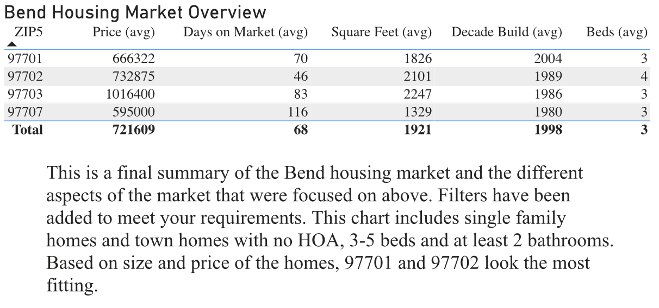
Final Overview
Technical Work:
Filter added to focus in on 3-5 Bedrooms and 2-4 bathrooms. Another filter was added so only homes with no HOA and that are single family are shown.

Slide 10
Conclusion
I recommend focusing on 97702
On average homes are more expensive than 97707 and 97701 but they are still below your budget at $732,000.
4 bedrooms on average gives room for both kid’s room and an office for Mr. Smith
Significantly more square footage than the other two zip codes in price range
Homes are on the older side at an average of 1989 leaving plenty of room for upgrades and personalization

